Slide 1

MOTION DETECT SECURITY CAMERA
HIMANSHU AGGARWAL
01196403116
5-I-7

Slide 2
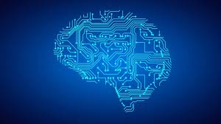
TRAINING IN PYTHON AND MACHINE LEARNING
Machine learning is an application of artificial intelligence (AI) that provides systems the ability to automatically learn and improve from experience without being explicitly programmed.

Slide 3

Motion Detect Security Camera What is this?
It detect motion
Click photo accordingly
Send you the alert
don’t use any expensive tool

Slide 4
HEADER FILE USED
import cv2
import numpy as np
import os
import time
from threading import Timer
import smtplib
from email.mime.text import MIMEText
from email.mime.image import MIMEImage
from email.mime.multipart import MIMEMultipart

Slide 5

OPEN CV
It is a library of programming functions mainly aimed at real-time computer vision.
In our project we use
cv2.createBackgroundSubtractorMOG2() Function

Slide 6

EXACTLY WHAT IS DO ?
Sense movement in house
It the movement cross beyond the threshold level
It alert the user
So the action can taken on time
We can also customize the camera

Slide 7
ADVANTAGES
Save space tremendously.
Send you the proof in real time
No need to check the camera again and again
Save the proof on local disk too
If the net is not connected still take action

Slide 8
DISADVANTAGES
If the internet is connection is not proper we don’t get the real time data.
Sometime it may sense the fake movement.
It do not sense the motion in dark.

Slide 9
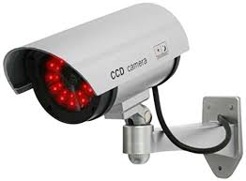
CONCLUSION
The motion detect security camera has proved to be of a fairly good efficiency.
It works better than any other other camera.

Slide 10


